Slide 1
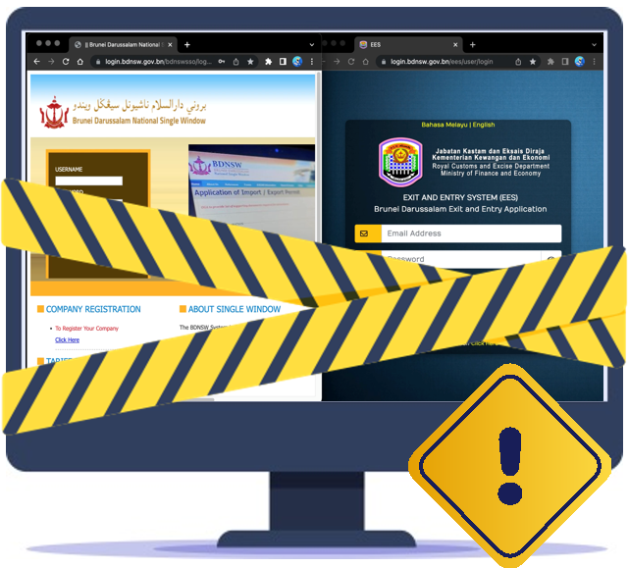
Jabatan Kastam dan Eksais Diraja
Kementerian Kewangan dan Ekonomi
MAKLUMAN
Para pengguna yang dihormati, Sila ambil maklum bahawa sistem Brunei Darussalam National Single Window (BDNSW) dan Exit and Entry System (EES) tidak akan dapat diakses disebabkan oleh kerja-kerja pemeliharaan yang dikendalikan oleh pihak Payment Gateway Service Operator, Kementerian Kewangan dan Ekonomi.
Hari | : | Sabtu, 30hb Mac 2024
Bermula jam | : | 6:00 hingga 7:30 pagi
Anggaran masa | : | 1 Jam 30 Minit
Pihak kami memohon maaf di atas sebarang kesulitan. Terima kasih.
Untuk keterangan lanjut:
+(673) 2382333
+(673) 2382361
​Isnin - Khamis & Sabtu
07.45 AM – 12.15 PM
01:30 PM – 04.30 PM
info@customs.gov.bn
customs.itu@customs.gov.bn
https://tradingacrossborders.mofe.gov.bn https://bdnsw.mofe.gov.bn

Slide 2
Royal Customs and Excise Department
Ministry of Finance and Economy
ANNOUNCEMENT
Dear valued users, Please be informed that Brunei Darussalam National Single Window (BDNSW) and Exit and Entry System (EES) will not be available due to maintenance activities conducted by the Payment Gateway Service Operator, Ministry of Finance and Economy.
Date | : | Saturday, 30th March 2024
Starting from | : | 6:00 AM until 7:30 AM
Estimated Time | : | 1 Hour 30 Minutes
We apologise for any inconvenience. Thank You.
For more information:
+(673) 2382333
+(673) 2382361
​Monday - Thursday & Saturday
07.45 AM – 12.15 PM
01:30 PM – 04.30 PM
info@customs.gov.bn
customs.itu@customs.gov.bn
https://tradingacrossborders.mofe.gov.bn https://bdnsw.mofe.gov.bn

